Slide 1

Designing Software
Mark B. Friedman
Lecturer, Allen School of Computer Science & Engineering

Slide 2

Software Design
"...specification of a software artifact, intended to accomplish goals, using a set of primitive components ..." [wikipedia]

Slide 3

Class Timeline
Lecture
Design: why & how
Use cases
Component specification
10 min: Team component specification (Breakout session: ~4 members)
5 min: Team reports
Remainder: Work in teams

Slide 4
Outline
The Software Development life cycle and trends in Software Development Methodologies
Re-usable Components and Object-oriented Design
About the design process
Principles of Software Design

Slide 5

The software design process
Good designs evolve
They emerge, building block by building block, layer by layer, from a process of continuous improvement in response to both new information and new requirements
Many good ideas do not survive their collision with the reality of software development.
Treat design decisions as provisional
The final design inevitably will diverge from the original spec.

Slide 6
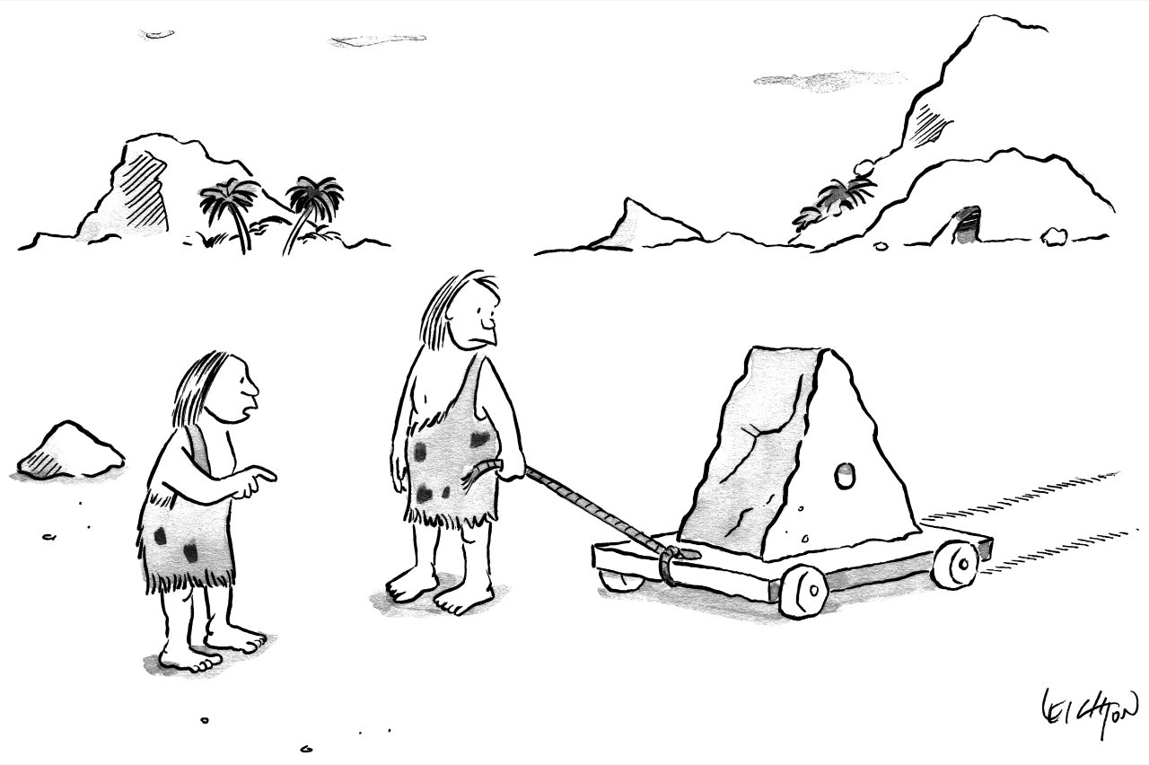
The software design process
Good designs evolve and sometimes you just get lucky!

Slide 7
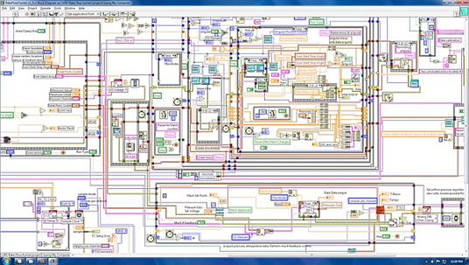
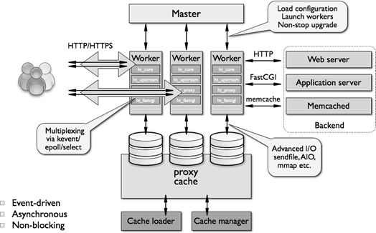
Principles of software design
The Design document
What Makes a Design Understandable?
Few components with clear roles
Use abstraction hierarchies
Few interactions between components
Carefully choose the features and interfaces
Similarity with other designs
Use known design patterns, where applicable

Slide 8

Principles of software design
Some Known Design Patterns
Layered architecture
Hierarchical architecture
Bridges, Wrappers, Proxies
Client-Server; Master-Slave; Publish:Subscribe
Worker threads: Work items (concurrency)
Role-based security
Structured exception handling
Model-View-Controller
Don’t re-invent this

Slide 9
Principles of software design
A good design document…
Offers a systematic approach to understand a complex problem
May expose problems/bugs before you begin coding
Enables people in a team to work in independently in parallel
Promotes testability

Slide 10
Principles of software design
Design Stages
Functional design:
Describe what the system does (use cases)
Component design:
Specify components that implement the function
Each use case has a "Top level" component.
Sub-components implements portions of the use case
Try to identify components that are common to multiple use cases
Iterate

Slide 11
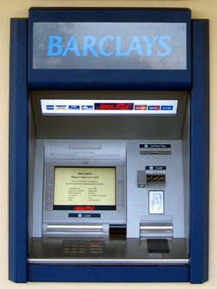
Principles of software design
Functional design
Software to run an
Automated Teller machine (ATM)
This Photo by Unknown Author is licensed under CC BY-NC

Slide 12
Principles of software design
Use cases
What user interaction scenarios do you need to support?
Get cash
Get cash quick!
Deposit checks
Check balance
Customer authentication!
This Photo by Unknown Author is licensed under CC BY-NC

Slide 13
Principles of software design
Describe a Use case
What information the user provides
E.g., command entered with its options
What responses the system provides
E.g., prompts, reports, error messages
Scenario | Customer authentication
Initiate access | Customer puts her ATM card in Reader
Prompt for PIN | System: Display 'Enter PIN'
Wait for response | Customer enters PIN on keyboard & presses “Enter” key
Validate | If valid: show Main menu Else: System: Display ‘Error! Please re-enter your PIN'

Slide 14
Principles of software design
Elements of a functional specification
Background: describe the problem being addressed.
User profile: Who uses the system. What they know about the domain and computing (e.g., can browse the web, can program in Python)
Data sources. What data you will use and how it is structured.
Use cases.
Objective (e.g., withdraw money from an ATM)
Expected interactions between the user and your system
This Photo by Unknown Author is licensed under CC BY-NC

Slide 15
Principles of software design
Component design
Software to run an
Automated Teller machine (ATM)
This Photo by Unknown Author is licensed under CC BY-NC

Slide 16
Principles of software design
Elements of a component specification
Goal: provide sufficient detail so that someone with modest knowledge of the project can implement the code for the component.
Name
Describe its function
specify its Methods(), including
Inputs (parameters)
Outputs (return values)
Interactions with other components
This Photo by Unknown Author is licensed under CC BY-NC

Slide 17
Principles of software design
Component and subcomponents
What role does it play in the implementation? (i.e., the Use Cases)
What (sub)-components are already available
What are the sub-components needed to implement those components that aren't already available?
Repeat steps 1-2 for each sub-component
The hierarchy of components and their sub-components is known as your Object Model
This Photo by Unknown Author is licensed under CC BY-NC

Slide 18
Principles of software design
Objects = Components
In Object-Oriented Programming (OOP), Objects are components consisting of
Data attributes
Data primitives (int, float, chars, strings)
other embedded Objects
Methods()
function arguments & return values
and both Public and internal surfaces
to try to reduce unexpected interactions between components
This Photo by Unknown Author is licensed under CC BY-NC

Slide 19
Principles of software design
Example component specification
Name
FindPrimes function
What it does:
Finds the primes that are less than N
Inputs (with type information)
N, an integer
Outputs (with type information)
List of integers
This Photo by Unknown Author is licensed under CC BY-NC

Slide 20
Principles of software design
Pseudocode Example
Pseudo code for finding the primes < N
Divides(n,d) function returns True if remainder (n/d) = zero
This Photo by Unknown Author is licensed under CC BY-NC
For Each n < N {
let is_prime bool = True;
For Each d < n
{ if divides(n,d)
Then { is_prime = False; break; }}
if is_prime Then add n to the list_of_primes }
return list_of_primes
Be concise; not too many details
Be consistent using variable names and flow control logic
readable English when describing a code segment

Slide 21
Your Turn: ATM Components Use Cases
Authenticate user scenario
Database with user PIN
User interface that reads ATM card
User interface that reads user PIN
Control logic
Get cash scenario
Database with users cash balance
User interface that reads user cash requested
Cash drawer interface that dispenses cash
Control logic
This Photo by Unknown Author is licensed under CC BY-NC

Slide 22
The Next 10 Minutes
Your charter: Design for Authenticate User
List of components of their interactions
Who calls whom for each step in the use case
Component(s) design using the design template
What you'll report: Very brief
Summary of design
Issues, open questions

Slide 23
Team Component Specifications 10 min

Slide 24
Team Results 5 min

Slide 25
Report
What we designed
Which components
What detail
What issues encountered
What to do differently

Slide 26
Technology Review Presentations
Making decisions about the choice of a python library to address a technology need
Ex: choose map visualizations
Bokeh, Dash, and googlemaps.
choose a library that: (a) addresses your requirements; (b) compatible (e.g., runs on python 3); (c) easy to use; (d) computationally efficient; (e) doesn’t have software bugs that will impair your use cases.

Slide 27
Begin Project Functional Specification

Slide 28
Project Standups
What you’ve accomplished to date
Next steps
Blockers

Slide 29
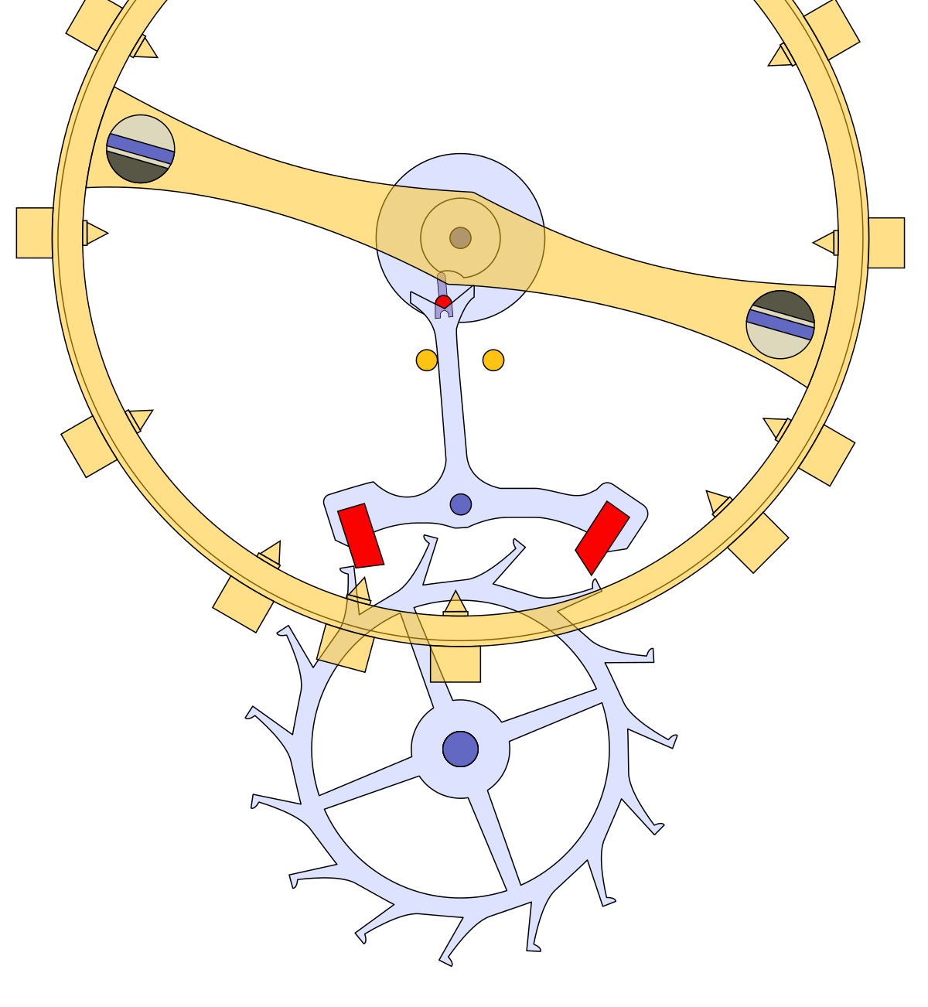
The software design process
Understand who is your target audience?
Write once, run once
Write once, run many time on your own equipment
Write once, run by many people on different equipment
Team development, run by many people on different equipment
Develop, document and enhance over many successive versions
Develop and hope to sell to others

Slide 30
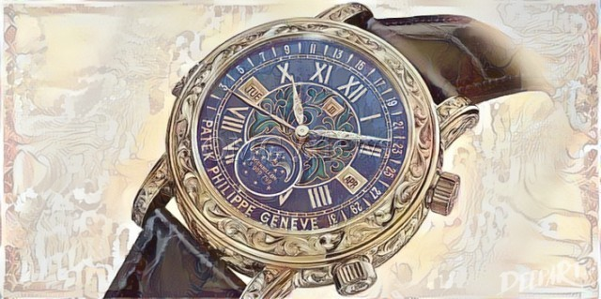
The software life cycle
Do you expect this software to be used productively for many years?
1 year or less, 5, 10, or 20 years or more
Does it need to run occasionally, periodically, daily, or continuously across many, many computers

Slide 31
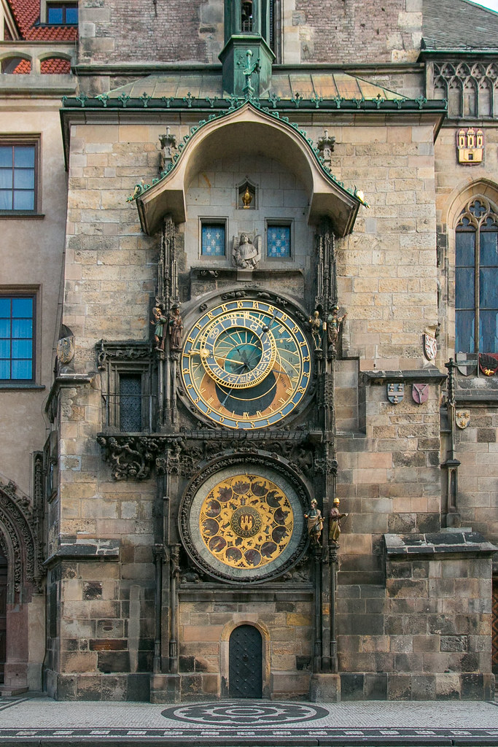
The software design process
Different design processes animate a project depending on its target audience and intended use over many years

Slide 32
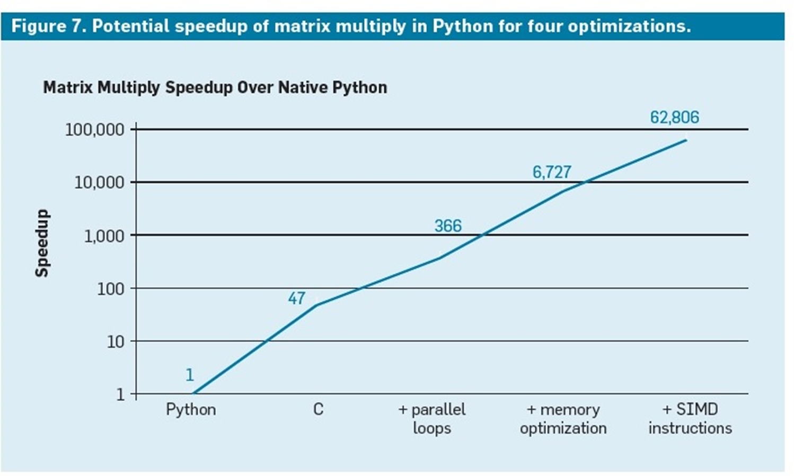
What is software engineering?
Who is your target audience?
Do you expect this software to be used productively for many years?
Does its performance matter?
source: “A New Golden Age for Computer Architecture,” by JOHN L. HENNESSY AND DAVID A. PATTERSON, CACM.

Slide 33

First, a few words about Bugs!
You are never sure when you first ship your code beyond your development and test environment to customers and prospects that it is bug free.
Assume there are bugs waiting to happen when your code encounters new environments and other unanticipated conditions.
So, roll out your code gradually... in stages, and wait for the bug reports to roll in.
Alpha test
Beta testing
Initial rollout
Begin to go wider

Slide 34
Bugs!
Bug severity
Bugs are classified based on their impact on customers.
Impact has two dimensions:
the number of customers affected
not just the number of bug reports
the degree that that bug impairs the software’s usability
this is a spectrum, ranging from
minor annoyances
major features won’t function properly
data corruption
the software won’t even install or run
the software does damage to critical components on your customer’s computer

Slide 35

Bug reproducibility
If the bug is reproducible in your development and test environment, then it is fixable by any competent software engineer.
How do you handle severe bugs that cannot be reproduced in your development lab?
Ignoring them (marking them CLOSED: no Repro) is not a viable option unless you are Too Big to Fail!
The application needs to be able to produce enough specific diagnostic information that common bugs can be diagnosed indirectly

Slide 36
Bugs!
Structured Exception Handler Rules
They provide an opportunity to recover from error conditions your code encounters
Or, record a diagnostic message, the more specific and more detailed the better!
Structured Exception handling
try:
[code block..]
except exception as Ex:

Slide 37
Bugs!
Structured Exception Handler Rules
They provide an opportunity to recover from error conditions your code encounters
Or, record a diagnostic message, the more specific and more detailed the better!
Structured Exception handling
try:
: # do something
pass
except ValueError:
: # handle ValueError
pass
except (TypeError, ZeroDivisionError ):
# handle multiple exceptions
# TypeError and ZeroDivisionError
pass
except::
# handle all other exceptions
pass

Slide 38
Bugs!
Structured Exception Handler Rules
Exception handler blocks have scope, and they can be nested.
When they do cascade, the values of local variables that might have clues to what happened to cause the exception fire residing in nested blocks of code disappear.
Have them cascade from the specific to the general
Structured Exception handling
try:
: # do something
pass
except ValueError:
: # handle ValueError
pass
except (TypeError, ZeroDivisionError ):
# handle multiple exceptions
# TypeError and ZeroDivisionError
pass
except::
# handle all other exceptions
pass

Slide 39
Bugs!
Structured Exception Handler Rules
They provide an opportunity to recover from error conditions your code encounters
Or record a diagnostic message, the more specific and more detailed the better!
Exception handler blocks have scope, and they can be nested.
Structured Exception handling
try:
: # do something
pass
except ValueError:
: # handle ValueError
pass
except (TypeError, ZeroDivisionError ):
# handle multiple exceptions
# TypeError and ZeroDivisionError
pass
except::
# handle all other exceptions
pass

Slide 40
Bugs!
Structured Exception Handler Rules
Not possible to recover from all error conditions
e.g., Out of Memory bugs
Recovering from hardware instruction exceptions is very costly!
They should not be invoked routinely, except where it is unavoidable
Use normal procedural code to check for common error conditions
Structured Exception handling
try:
: # do something
pass
except ValueError:
: # handle ValueError
pass
except (TypeError, ZeroDivisionError ):
# handle multiple exceptions
# TypeError and ZeroDivisionError
pass
except::
# handle all other exceptions
pass

Slide 41

Software Engineering is a new discipline…
What are the elements of software quality that we recognize?
Was it delivered on time?
Did it meet its requirements?
Was it difficult to use?
Was it buggy or difficult to maintain?
Was it adopted?
Did it fulfill expectations?
Are customers satisfied?

Slide 42
Software Engineering is a new discipline…
Developing complex software is extremely difficult!
Larger projects require more people, but more people on the team can cause team productivity to degrade.
Mythical Man-month
Designing the UX, the database back-end, and structuring the code in the middle each requires different skill sets
Software development projects often fail – they don’t deliver on time, don’t deliver adequate function, don’t scale to required performance levels, or they are buggy and resistant to change.
New development vs. software maintenance
Learning how someone else’s code works in order to fix it or extend it is more difficult than your writing new code from scratch

Slide 43
Software development is a big business
What are the elements of software quality that we recognize?
Was it delivered on time?
Did it meet its requirements?
Was it difficult to use?
Was it buggy or difficult to maintain?
Was it adopted?
Did it fulfill expectations?
Does it generate adequate revenue?

Slide 44
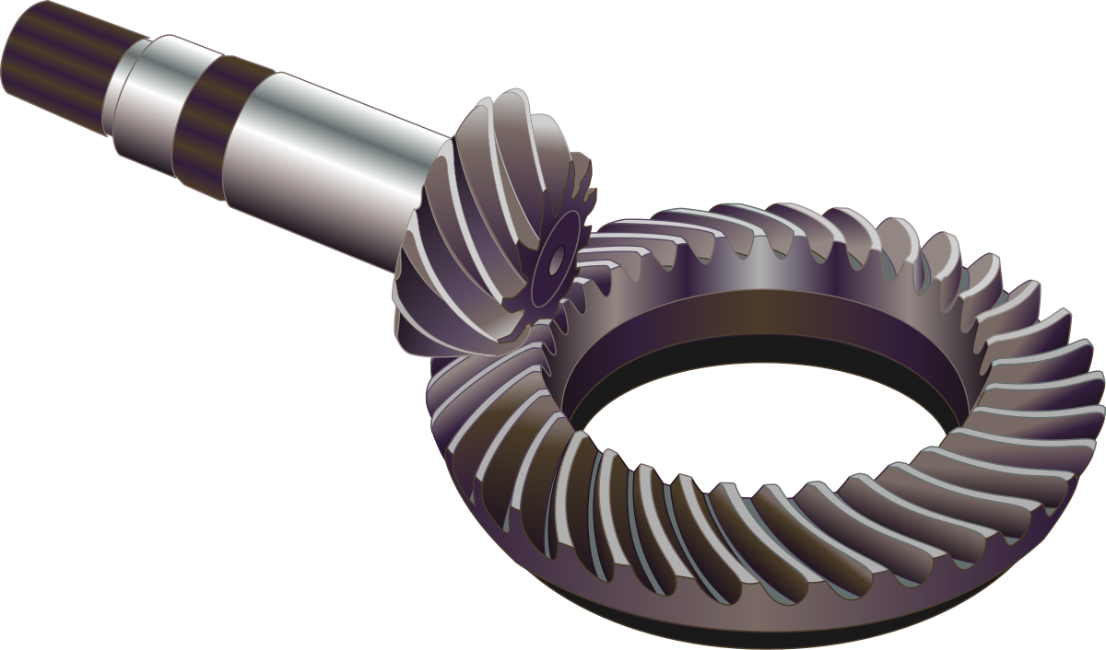
Software development methodologies (SDM)
New SDM paradigms emerge from time to time to address very specific problems that large scale software development efforts seem to encounter, often in response to innovation and technological change.
e.g., on-screen IDE programming replaces annotated source program listings
“Hungarian” naming convention for tagging variable types
obsoleted by IDE “intellisense”

Slide 45
Software Engineering is a new discipline…
This is a new discipline. We are still learning how to build quality software. Here’s are some of things that people have tried:
DevOps
Continuous integration
Agile
Prototyping; Rapid Application Development (RAD)
Object-oriented design
Software layers & Design Patterns
Components and re-usable code
Structured code

Slide 46
Software development methodologies (SDM)
SDM | Problems that the SDM tries to address
DevOps | 24 x 7 networked operations; dev skills are needed to fix critical bugs
Continuous integration | Resolve conflicts associated with multiple teams checking in code developed in isolated branches more frequently
Agile | Adjust to rapidly changing requirements; Time to market; Fail faster paradigm; shortfall in critical communication skills
Object-oriented design | Minimize side effects from re-usuable code
RAD; Prototyping | Leverage software librariues & other pluggable components; 4th generation programming languages; Fail faster paradigm
Layers & other design Patterns | Benefit from past mistakes; don’t keep re-inventing the wheel
Components and other re-usable code libraries | Potential to build complex systems more efficiently by re-use of reliable components; Build vs. Buy decisions
Structured code & design | Spaghetti code difficult to maintain

Slide 47
Software Development Life Cycle
Requirements Analysis
Specifications
Coding
Acceptance Testing
Production Rollout
Originally, all software was developed by in-house staff, by the hardware vendor, or by 3rd party consultants doing work for hire
Packaged Software developed by the federal government & placed in the public domain
Independent Software Vendors (ISVs) emerged in the 1970s
Programmer productivity utilities
Data center management utilities
Financial accounting
ISVs often began life as consultants

Slide 48
Waterfall methodology
Requirements Analysis
(Business Analyst)
Specifications
(System Analyst)
Coding
(Programmers)
Acceptance Testing
(QA & Business Analysts)
Production Rollout
(Data center operations)
In theory, application development was to proceed in a series of orderly, distinct phases
Programmers lack domain-specific knowledge about the application’s requirements
During acceptance testing, the end user would find flaws in the implementation where the end result did not conform to the requirements
In practice, dealing with changing requirements was a huge problem!

Slide 49
Continuous Improvement model
Independent Software Vendors (ISVs) adopted a different set of processes around a continuous improvement model.
Too risky to undertake big development projects with long lead times
Accepted the reality that their software will never attain a finished form, but needs to keep evolving towards that goal
Requirements are always contingent; all the software that fits;
Release early and often; powered by the “maintenance” revenue stream
They cultivated domain-specific expertise in-house ⇨ Architects & Product Managers
Bug Fixes
Requirements
Specifications
Coding
Testing
Customer
Beta Testing
Release

Slide 50
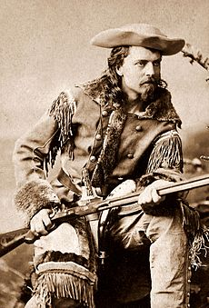
Continuous Improvement model
How to structure a large scale development project using a continuous improvement model.
In order to ship in a reasonable time frame, some compromise is inevitable.
Target the minimum (commercial) requirements for acceptance of an initial release.
Are there competitive issues?
Plan ahead! Put an architecture in place that is adequate and flexible enough for the next several releases.
Don’t spend too much time building something provisional in one release that you know you are going to have replace in a subsequent release.
Rinse
&
Repeat

Slide 51
Continuous Improvement model
How to structure a large scale development project using a continuous improvement model.
Risk management
Use scouting in advance of the coding phase to assess the riskiest aspects of the project
Schedule tasks so that key dependencies and other high risk factors are addressed first
Schedule tasks so that developers at the right experience and skill level are matched to the right tasks
Automated project management scheduling tools do not understand this dependency!

Slide 52
Continuous Improvement model
How to structure a large scale development project using a continuous improvement model.
Be bold; be aggressive.
Begin the coding phase for every release very expansively.
Be realistic.
Approximately, ½-way through coding, begin to scale back expectations and start to consider cutting back non-essential features
Be ruthless.
When you only have ~¼ of the time remaining, cut back any features that present a risk they will not be done in time
Microsoft “Shiproom” process: “Tell” mode transitions to “Ask” mode

Slide 53
Object-oriented programming (OOP)
What is an Object?
An Object in a language that supports OOP is a container for both data (Properties) and code (Methods) that operates on that data. This is known as encapsulation.
Typically, the language runtime provides a number of predefined Objects
Use a Class statement to define a new type of Object
An Object has a Constructor method that allows a caller to create a new instance of that type of Object.
Objects can be nested inside other objects.

Slide 54
Object-oriented programming (OOP)
What is an Object?
An instance of an Object has a public surface that defines the Properties a caller can access and the Methods that can be called, once an Object instance is created.
An instance of an Object can also contain private data not available for the caller to access, along with private Methods available only for use internally within the Object instance.
The boundary between the public and private surface of an Object is designed to minimize code interactions that have unanticipated side effects!

Slide 55
Object-oriented programming (OOP)
Inheritance
An Object of one type can inherit Properties and Methods from another type of Object. Inheritance or sub-classing leads to derived types.
Derived types can add Properties and Methods to the ones inherited from the parent class. They can also override the default properties and methods they inherit.
Many OOP languages support inheritance from multiple classes

Slide 56
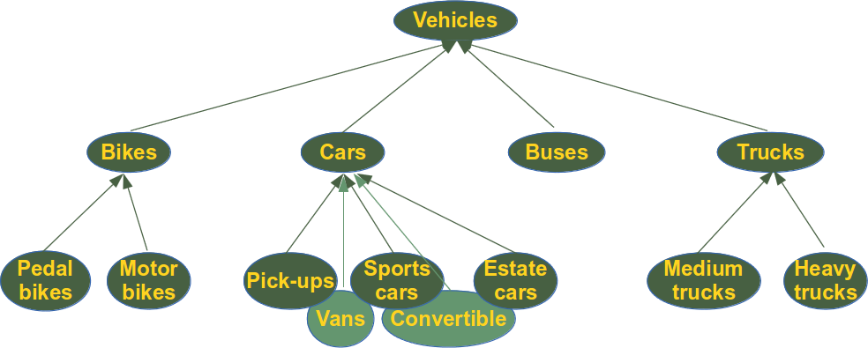
Object-oriented programming (OOP)
Inheritance: a Class hierarchy

Slide 57
Object-oriented programming (OOP)
Recognizing the expressive power of OOP constructs, most modern programming language support some form of Objects
Strongly-typed OOP languages

